Slide 1
EASY VISA pROJECT
EXPLORATORY DATA ANALYSIS REPORT

Slide 2
Problem Overview
OFLC processes job certification applications for employers seeking to bring foreign workers into the United States and grants certifications in those cases where employers can demonstrate that there are not sufficient US workers available to perform the work at wages that meet or exceed the wage paid for the occupation in the area of intended employment.
The process of reviewing every case is becoming a tedious task as the number of applicants is increasing every year. In FY 2016, the OFLC processed 775,979 employer applications for 1,699,957 positions for temporary and permanent labor certifications which was a nine percent increase in the overall number of processed applications from the previous year.
The task at hand to analyze the data provided to facilitate the process of visa approvals by building a machine learning model and to recommend a suitable profile for the applicants for whom the visa should be certified or denied based on the drivers that significantly influence the case status.

Slide 3
Data Overview
The data contains information of 25480 employees and their employers.
There are 25480 rows and 12 colums in the dataset.
The dataframe has no null or duplicate value.
All the columns were of object datatype except prevailing_wage, yr_of_estab and no_of_employees which are numerical values.
The data includes information about employee’s education, job experience, whether the employee requires training or not, continent, etc.
The data also includes information about the number of employees in the company, year of establishment of the company, prevailing wage, etc.
The case_id column was dropped from the dataset since all the values in that column were unique.
There were some negative values in the number of employees column which were replaced by their absolute values.
There were quite a few outliers in the data, however, they were not treated since they were genuine values.

Slide 4
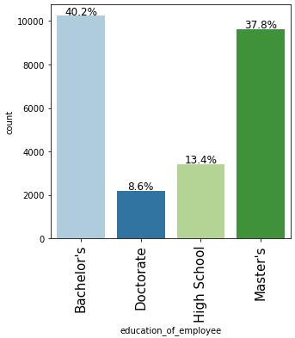
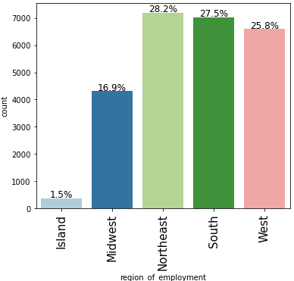
Exploratory Data Analysis
40.2% of the applicants have a bachelor's degree, followed by 37.8% having a master's degree.
8.6% of the applicants have a doctorate degree.
Northeast, South, and West have almost equal percentages of applicants. (25%-28%)
The Island regions have only 1.5% of the applicants.

Slide 5
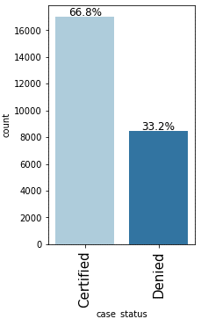
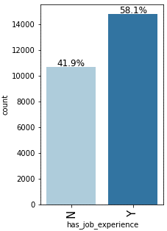
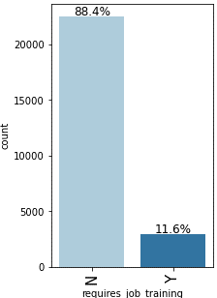
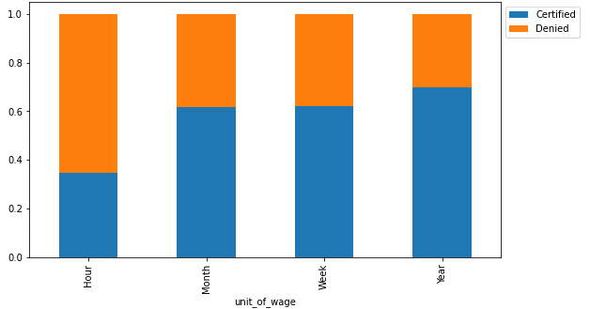
Exploratory Data Analysis
66.8% of the visas were certified.
58.1% of the applicants have job experience.
88.4% of the applicants do not require job training.
Unit of prevailing wage is an important factor for differentiating between a certified and a denied visa application.
If the unit of prevailing wage is Yearly, there's a high chance of the application getting certified.
Around 75% of the applications were certified for the applicants who have a yearly unit of wage. While only 35% of the applications were certified for applicants who have an hourly unit of wage.

Slide 6
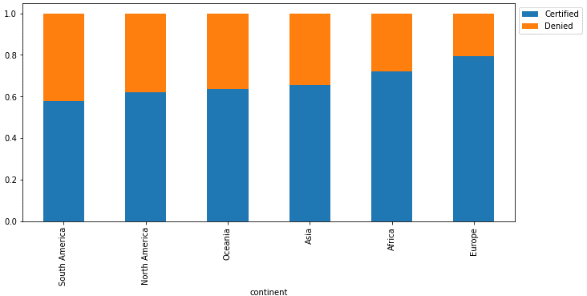
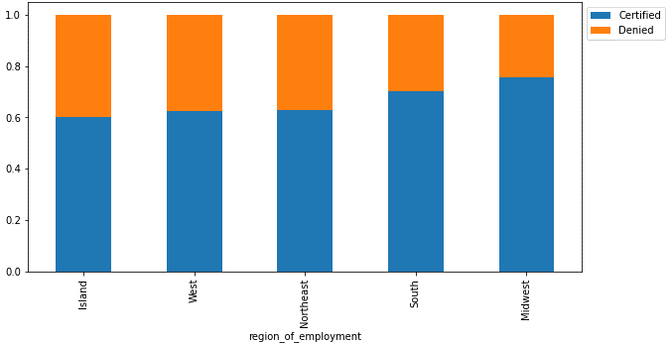
Exploratory Data Analysis
Applications from Europe and Africa have a higher chance of getting certified.
Around 80% of the applications from Europe are certified.
Asia has the third-highest percentage (approx. 60%) of visa certification and has the highest number of applications.
Midwest region sees the highest number of visa certifications (approx. 75%), followed by the south region (approx. 70%) of the visa applications getting certified.
Island, West, and Northeast region has an almost equal percentage of visa certifications.

Slide 7
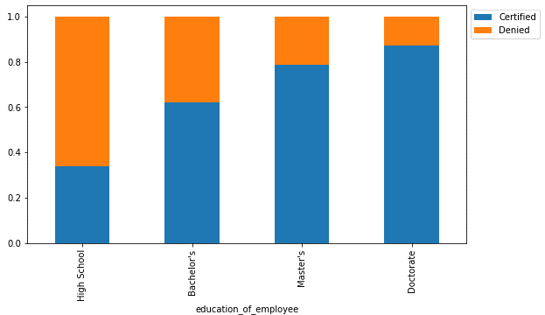
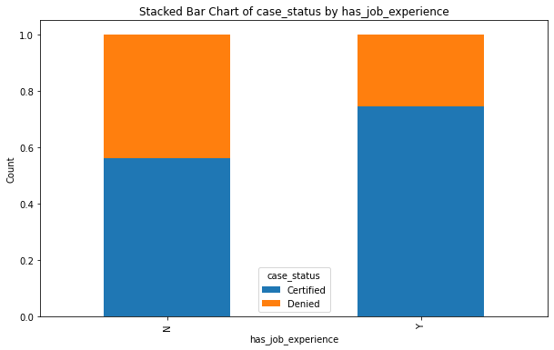
Exploratory Data Analysis
Education seems to have a positive relationship with the certification of visa. The higher the education, the higher the chances of visa getting certified.
Around 85% of applicants with Doctorate degree had their visa applications certified compared to Master’s degree applicants that had 80% of the visa applications certified.
Around 60% of the visa applications got certified for applicants with Bachelor's degrees.
Applicants who do not have a degree and have graduated from high school are more likely to have their applications denied.
those that have job experience have a higher chance of their visa being certified with about 74%
but about 56% of people who didnt have a job experience also got their visa certified

Slide 8
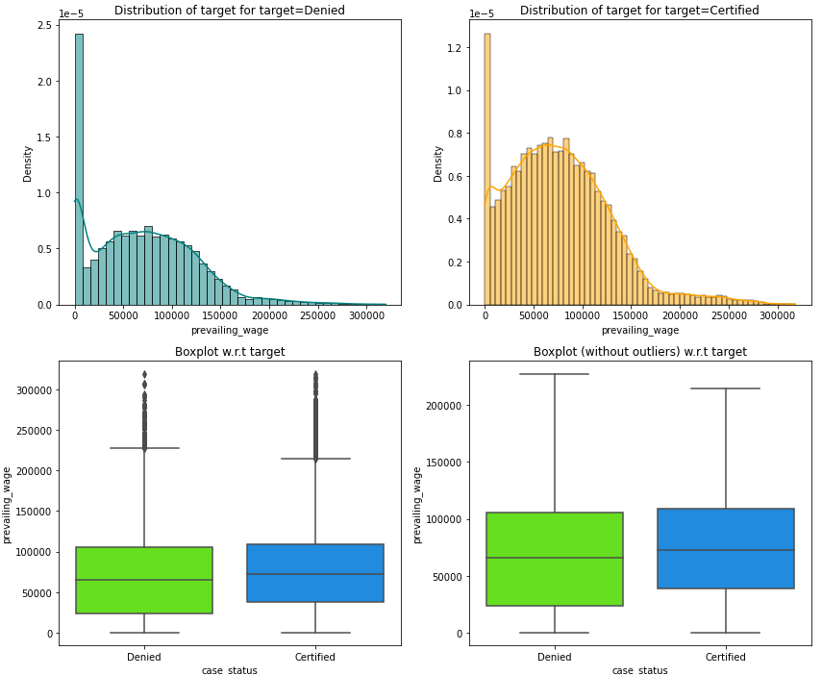
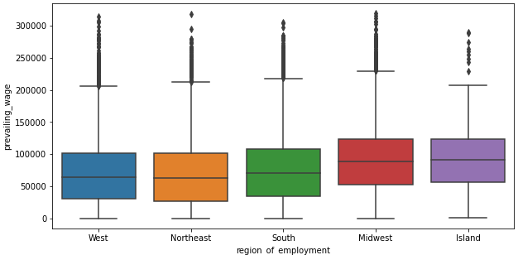
Exploratory Data Analysis
Midwest and Island regions have slightly higher prevailing wages compared to other regions.
The distribution of prevailing wage is similar across West, Northeast, and South regions.
The median prevailing wage for certified applications is slightly higher compared to denied applications.

Slide 9
Model Performance Summary
We want to predict whether the visa application will get certified or not using the information provided.
We will use F1 Score as the metric for evaluation of the model because
Although since Since visa certification involves making important decisions about granting visas to employees, we need to be cautious about both false positives (approving visas for employees who shouldn't be eligible) and false negatives (rejecting visas for eligible employees). F1 score will help us to minimize both false positives and false negatives.
We will use balanced class weights so that model focuses equally on both classes.
We will build different models - DecisionTreeClassifier, RandomForestClassifier, AdaBoostClassifier, and GradientBoostingClassifierr.
We will also perform hyperparameter tuning for these models and evaluate their performance using different metrics and confusion matrix.

Slide 10
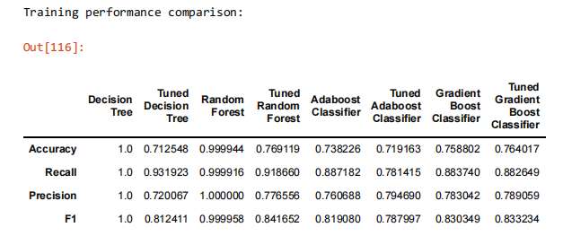
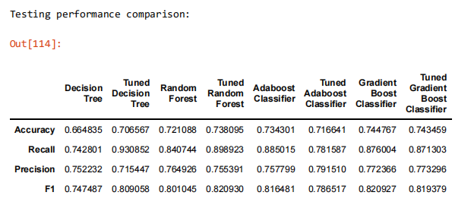
Model Performance Summary
Based on the provided test performance comparison, the model with the highest overall F1-score is the
"Tuned Random Forest" classifier, with an F1-score of approximately 0.8209.

Slide 11
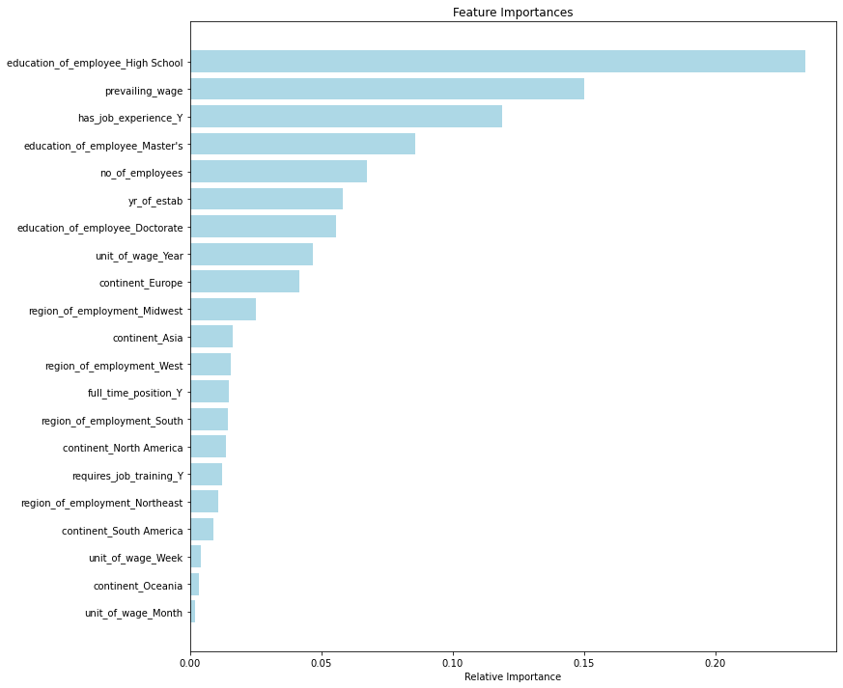
Feature Importance
The top 3 important features to look for while certifying a visa are:
Education of the employee
Job experience
Prevailing Wage.

Slide 12
INSIGHTS
The profile of the applicants for whose visa can be certified:
Education level - At least has a Bachelor's degree - Master's and doctorate are preferred.
Job Experience - has job experience.
Prevailing wage - has a high prevailing wage most likely yearly (The median prevailing wage of the employees for whom the visa got certified is around 72k. )
Continent - it has been observed that applicants from Europe, Africa, and Asia have higher chances of visa certification.
The profile of the applicants for whom the visa status can be denied:
Education level - high school degree.
Job Experience - Doesn't have any job experience.
Prevailing wage and unit of wage - applicants with hourly units of wage (The median prevailing wage of the employees for whom the visa got certified is around 65k.)
Continent - it has been observed that applicants from South America, North America, and Oceania have higher chances of visa applications getting

